Slide 1

356815008
344663000
52040792
312511520
Telco Global API Alliance
26.05.2021

Slide 2
A global partnership could address much of the challenges in scaling API services across heterogenous operator architectures.
The development of open, global, and interoperable API solutions could benefit customers and developer ecosystems by giving access to capabilities in whatever network customers are in and therefore allow applications to run consistently between telco networks and countries. A new form of collaboration between various players (telcos, ISVs, device manufacturers, hyperscalers, etc.) could advance the connectivity industry towards a more robust and faster core network, encourage the faster adoption of capabilities and as a result create value for the entire tech industry.
1. Accelerate technology development
Build sustainable ecosystems around collaborative projects across industries.
Drive industry alignment by facilitating industry discussions with telcos, ISVs, device manufacturers, hyperscalers, etc.
2. Standardization of APIs
Standardize and convert APIs to a user understandable format called “Service APIs”.
Achieve standardization through working code vs. documents.
Implementation experience should guide standardization process.
Enable interoperability (e.g. API roaming).
3. Education and promotion
Actively promote Service APIs via various forums, events, conferences, ecosystems and social media.
Promote best practices by aggregating and publishing lessons learned.
4. Accelerate commercial adoption
Create awareness around use cases and services.
Minimize implementation effort though standardized Service APIs.
Provide customer service and support.

Slide 3
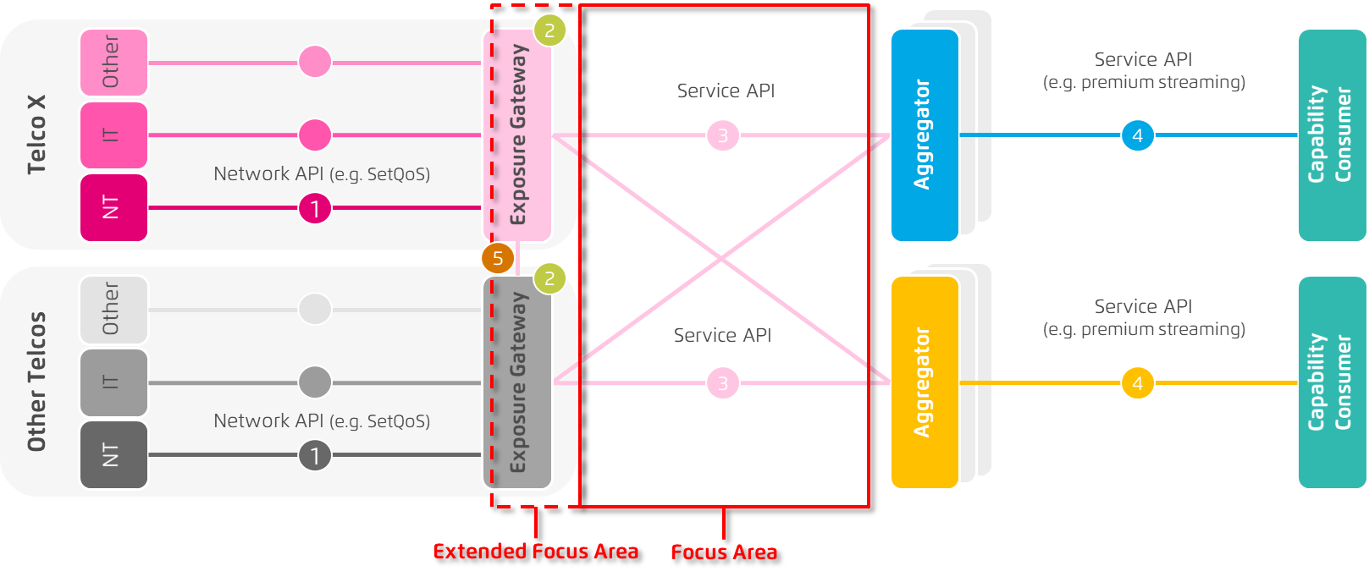
APIs grouped by services and bundled up into “Service APIs” reduce the complexity of accessing capabilities for developers and enterprises.
1
Capabilities Exposable via Network APIs e.g. slicing, positioning, managed QoS, IDM etc.
2
Exposure Abstraction of internal API to Service APIs. Common means of access across all operators
3
Service APIs
Service APIs incl. also access
control, billing, cross-operator federation etc.
4
Technical Aggregation (optional)
Enrichment to Service API e.g. hyperscalers, MEX etc.
5
Interoperability
e.g. API roaming, etc.

Slide 4


DT has evaluated three options to start the alliance.
Independent Entity
GSMA
Hybrid Approach “CNCF & GSMA”
As an independent Foundation the Global API Alliance is able to create its own governance structure, operating model, rules and community.
Objective: Facilitate collaborative projects driven and resourced by GSMA Members
Activities are governed by the overall GSMA regulatory framework but not subject to the general rules of participation associated with other GSMA activities.
The CNCF hosts critical components of the global technology infrastructure.
CNCF brings together the world’s top developers, end users, and vendors and runs the largest open-source developer conferences.
CNCF is part of the nonprofit Linux Foundation.
+ GSMA
GSMA
CNCF
Steering and Gov. Bodies
Regulatory Guidance
Open-Source Development
Marketing
Billing & Charging
Roaming
Community Adoption
Pros & Cons
Completely Independent.
Slow setup.
Bureaucratic and legal overhead costs for launch.
Actively responsible for following regulations concerning unfair competition and antitrust law.
Easy and fast setup.
No bureaucratic and legal overhead costs for launch.
Ideal for collaborative projects.
Limited to the hosts rules and conditions.
Does not provide the infrastructure for API development.
Easy and fast setup.
No bureaucratic and legal overhead costs for launch.
Provides the infrastructure for API development and collaborative projects.
Limited to the hosts rules and conditions.

Slide 5


A hybrid approach (GSMA + CNCF) might be a reasonable solution.
Project Steering Committee
Project Maintainers
Project Manager
Open Source Developer Community
Private Global API Team
Gate 1
API ready
for testing
Gate 2
API tests concluded
Working Group
Gate 3
API ready for deployment
1. Develop pre-standards APIs
in CNCF
Create visibility with target developers
Provide intent-based APIs through familiar technologies (etc, NATS)
Showcase operator partnerships to rest of the industry
2. Test the pre-standards with Telcos
Identify developer pain, performance bottlenecks, and poor scaling
Adjust protocols and implementations as problems arise
Engage with projects through Linux membership or CNCF End User Community
3. Publish APIs in GSMA
Document APIs and releases in parallel to development
Define use cases
API deployment and go-to-market (Out of scope)

Slide 6
Reach agreement with partners on the approach to take.
Reach out to GSMA and CNCF to start the processes.
Define collaboration structure.
Define communication between CNCF and GSMA.
Identify stakeholders.
Define stakeholder responsibilities.
Define project governance.
Define project name.
Next steps

